Slide 1
வணக்கம்

Slide 2
சங்க இலக்கியங்களுக்கான உருபன் பகுப்பாய்வி
இரா. அகிலன்
நிரலாளார்
செம்மொழித் தமிழாய்வு மத்திய நிறுவனம்
சென்னை

Slide 3
Morphological Analyzer
Morphological Analyzer is an essential and basic tool for building any language processing application. Morphological Analysis is the process of providing grammatical information of a word given with its suffix. Morphological Analyzer is a computer program which takes a word as input and produces its grammatical structure as output. Morphological analyzer will return its root/stem word along with its grammatical information depending upon its word category.

Slide 4
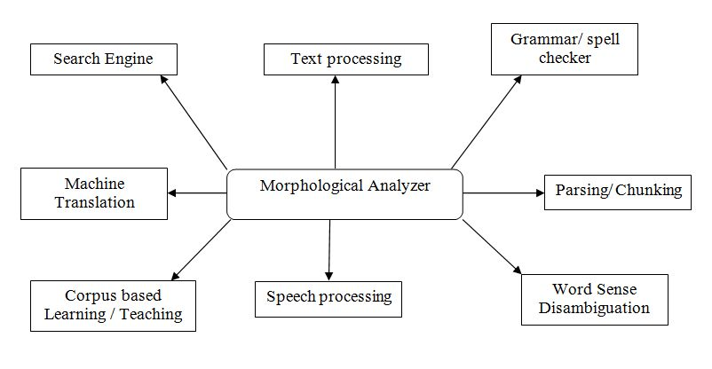
Morphological analyzer is playing important role in Natural Language Processing Applications

Slide 5
Rule-based Approaches
The rule-based approach has successfully been used in developing many natural language processing systems. Systems that use rule-based transformations are based on a core of solid linguistic knowledge. The linguistic knowledge acquired for one NLP system may be reused to build knowledge required for a similar task in another system. The advantage of the rule-based approach is 1) less-resourced languages, for which large corpora, possibly parallel or bilingual, with representative structures and entities are neither available nor easily affordable, and 2) for morphologically rich languages, which even with the availability of corpora suffer from data sparseness.

Slide 6
Tag sets
The tagset which has been used for the present research work contains major 10 categories Noun (NN), Verb (VB), Adjective (ADJ), Adverb (ADV), Pronoun (PR), Postposition (POS), Conjunction (CJ), Particles (PAR), Numerals (NL) and Markers (CM) and subdivided into further 34 categories

Slide 7
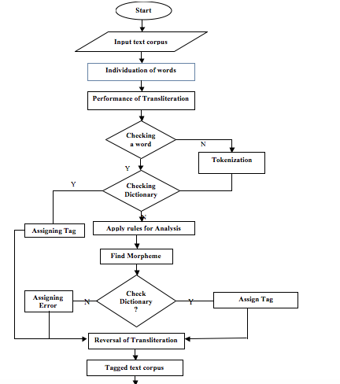

Slide 8
Dictionaries
The dictionaries plays important role in morphological analyzer. The primary data for Morphological Analyzer have been collected from Classical Tamil Literature. From this, the root word list has been prepared and verified by language experts. The root words have been collected from the authentic editions of Classical Tamil Literature. The database contains the ten root word categories that dictionaries include: the Noun, Verb, Adjective, Adverb, Pronoun, Postposition, Conjunction, Particles, Quantifiers, Numerals, Markers and suffix. The size of database contains around 10,000 words which includes all parts of speech categories

Slide 9
Plural markers
The different forms of plural markers in classical Tamil are kaḷ, mar, mār, ar, ār, ir, and īr. The ‘kaḷ’ forms in Tamil are in the different allomorphs of kaḷ, kkaḷ, ṅkaḷ, ṟkaḷ, and ṭkaḷ.

Slide 10
Segmentation rules
Step 1: Read the input word
If (word ) == (dictionary)
assign the appropriate tag
exit()
Step 2: (suffix word) == (‘kaḷ’)
{
split the suffix assign tag as ‘PL’
assign the remain word tag as ‘NC/NP/ND’
exit()
}
Step3: (suffix word) == (‘kkaḷ’)
{
  split the suffix and remove the first character ‘k’
  assign remaining suffix tag as ‘PL’
  assign the remain word tag as ‘NC/NP/ND’
  exit()
  }

Slide 11
Step4: (suffix word) == (‘ṅkaḷ’)
{
split the suffix and remove the first character ‘ṅ’
assign remaining suffix tag as ‘PL’
add(m) in the last character of root word
assign the tag as ‘NC/NP/ND’
exit()
}
Step5: (suffix word ) == (‘ṟkaḷ‘)
{
split the suffix and remove the first character ‘ṟ’
assign remaining suffix tag as ‘PL’
add(l) in the last character of root word
assign the tag as ‘NC/NP/ND’
exit()
}
Step6: ( suffix word ) == (‘ṭkaḷ’)
{
split the suffix and remove the first character ‘ṭ’
assign the tag as ‘PL’
add(ḷ) in the last character of root word
assign the tag as ‘NC/NP/ND’
exit()
}

Slide 12
Step7: ( suffix word ) == (‘mār’)
{
split the suffix assign tag as ‘PL’
check the dictionary assign the appropriate tag
exit()
}
Step 8: ( suffix word ) == (‘mar’)
{
split the suffix assign tag as ‘PL’
check the dictionary assign the appropriate tag
exit()
}
Step 9: ( suffix word ) == (‘ar’)
{
split the suffix assign tag as ‘PL’
check the dictionary assign the appropriate tag
exit()
}

Slide 13
Step 10 : ( suffix word ) == (‘ār’)
{
split the suffix assign tag as ‘PL’
check the dictionary assign the appropriate tag
exit()
}
Step 11 : ( suffix word ) == (‘ir’)
{
split the suffix assign tag as ‘PL’
check the dictionary assign the appropriate tag
exit()
}
Step 12 : ( suffix word ) == (‘īr’)
{
split the suffix assign tag as ‘PL’
check the dictionary assign the appropriate tag
exit()
}

Slide 14
Step 1: The input word is read by the system and if it is found in the dictionary; then the appropriate tag is assigned.
Ex. 1 If the given input மகள் (makaḷ) is checked into the dictionary. Then the tag is assigned. The result is displayed as மகள்/NC (makaḷ/NC)
    என் மகள் பெரு மடம் யான் பாராட்டத் (அக.397:1)
    eṉ makaḷ peru maṭam yāṉ pārāṭṭat (aka.397:1)
Step 2: The suffix word ‘kaḷ’ is checked and if it is found, the segment is separated and assigned as ‘PL’. Then the remaining word is checked in the dictionary and assigned as ‘NC/NP/ND’.
Ex. 2 If the given word is கிளைகள் (kiḷaikaḷ), the suffix ‘kaḷ’ is checked then the suffix is removed and assigned the tag as ‘PL’; the remaining part of the word is checked and if it is found in noun common category then the tag ‘NC’ is assigned; the result is கிளை/NC கள்/PL (kiḷai/NC kaḷ/PL).
  கேள்ஈவது உண்டு கிளைகளோ துஞ்சுப (நாலடியார்191:2)
  kēḷ īvatu uṇṭu kiḷaikaḷō tuñcupa (Nālaṭiyār191:2)

Slide 15
Step 3: The suffix ‘kkaḷ’ is checked, if it is found the segment is separated; the first character (k) is removed; then it is tagged as ‘PL’, the remaining part of the word is assigned as ‘NC/NP/ND’.
Ex.3 If the given input is அணுக்கள் (aṇukkaḷ). The suffix ‘kkaḷ’ is separated; the first character of the suffix ‘k’ is removed; then the remaining suffix is assigned as ‘PL’; check the remaining part of the word ‘aṇu’ in the dictionary; if it is found then the tag ‘NC’ is assigned; the result is அணு/NN கள்/PL (aṇu/NN kaḷ/PL).
நிறைந்த இவ் அணுக்கள் பூதமாய் நிகழின் (மணிமே.27:138)
niṟainta iv aṇukkaḷ pūtamāy nikaḻiṉ (maṇimē.27:138)
Step 4: The suffix ‘ṅkaḷ’ is checked. If it is found, the segment is separated; in the suffix ‘ṅ’ is removed; the remaining is tagged as ‘PL’; ‘m’ is added in the last character of the remaining part of the word and then it is tagged as ‘NC/NP/ND’.
Ex. 4 If the given input is குணங்கள் (kuṇaṅkaḷ) the suffix ‘ṅkaḷ’ is separated; the first character of the suffix ‘ṅ’ is removed; and assigned tag as PL; ‘m’ is added as the last character of the remaining part of the word and assigned the tag as NC. The result is குணம்/NC கள்/PL (kuṇam/NN kaḷ/PL).
கண்ணிய பொருளின் குணங்கள் ஆகும் (மணிமே.27:256)
kaṇṇiya poruḷiṉ kuṇaṅkaḷ ākum (maṇimē.27:256)

Slide 16
Step 5: The suffix ‘ṟkaḷ’ is checked. If ‘ṟkaḷ‘ is found, the segment is sepatated; in the suffix the ‘ṟ’ is removed; the remaining is tagged as PL; ‘l’ is added in the last character of the remaining part of the word and assigned the tagged as ‘NC/NP/ND’.
Ex. 5 The given input is சொற்கள் (coṟkaḷ) check the suffix‘ṟkaḷ’ segment the first character of the suffix ‘ṟ’ is removed assign the remaining suffix as PL, add ‘l’ in the last character of the remaining word and assign the tag as NN, the result is சொல்/NN கள்/PL (col/NN kaḷ/PL).
    திருந்துபு நீகற்ற சொற்கள் யாம்கேட்ப (கலி81:13)
    tiruntupu nī kaṟṟa coṟkaḷ yām kēṭpa (Kali 81:13)
Step 6: The suffix ‘ṭkaḷ‘ is checked, if ‘ṭkaḷ‘ is found, the segment is sepatated; in the suffix the ‘ṭ’ is removed; the remaining is tagged as ‘PL’; ‘ḷ’ is added in the last character of the remaining part of the word and assigned the tagged as ‘NC/NP/ND’.
Ex. 6 The given input is நாட்கள் (nāṭkaḷ) check the suffix ‘ṭkaḷ’ segment the first character of the suffix ‘ṭ’ then assign the remaining suffix is PL, add ‘ḷ’ in the last of the remaining word then assign the tag as NN. The result is நாள்/NCகள்/PL (nāḷ/NN kaḷ/PL).
    ஒன்று இட ஈட்டு வருமேல் நின் வாழ் நாட்கள்(ஐந்தி70-56:3)
    oṉṟu iṭa īṭṭu varumēlniṉ vāḻ nāṭkaḷ (Ainti 70-56:3)

Slide 17
Step 7: The suffix ‘mār’ is checked; the segment is separated and assigned as ‘PL’. Then the remaining word is checked in the dictionary and assigned as ‘NC/NP/ND’.
Ex. 7 The given input is பாவைமார் (pāvaimār) check the suffix ‘mār’ segment the suffix and assign the suffix as PL, the remaining word is assign as NN. The result is பாவை்/NC மார்/PL (pāvai/NC mār/PL).
    பாவைமார் ஆரிக்கும் பாடலே பாடல் (சிலம்பு.29:120)
    pāvaimār ārikkum pāṭalē pāṭal (cilampu.29:120)
Step 8: The suffix ‘mar’ is cheeked; the segment is separated and assigned as ‘PL’. Then the remaining word is checked in the dictionary and assigned as ‘NC/NP/ND’.
    Ex. 8 the given input is பதின்மர் (patiṉmar) check the suffix ‘mar’ segment the suffix and assign the suffix as PL, the remaining word is assign as NN. The result is பதின்/NC மர்/PL (patiṉ/NC mar/PL). முனியா ஏறுபோல் வைகல் பதின்மரை (கலி.108:48)
    muṉiyā ēṟupōl vaikal patiṉmarai (kali.108:48)

Slide 18
Step 9: The suffix ‘ar’ is cheeked; the segment is separated and assigned as ‘PL’. Then the remaining word is checked in the dictionary and assigned as ‘NC/NP/ND’.
Ex. 9 the given input is கிழவியர் (kiḻaviyar) check the suffix ‘ar’ segment the suffix and assign the suffix as PL, the remaining word is assign as NN. The result is கிழவி/NC அர்/PL (kiḻavi/NC ar/PL).
கிழவர் கிழவியர் என்னாது ஏழ்காறும் (பரி:11:120)
kiḻavar kiḻaviyar eṉṉātu ēḻkāṟum (pari:11:120)
Step 10: The suffix ‘ār’ is cheeked; the segment is separated and assigned as ‘PL’. Then the remaining word is checked in the dictionary and assigned as ‘NC/NP/ND’.
Ex. 10 the given input is பேதையார் (pētaiyār) check the suffix ‘ār’ segment the suffix and assign the suffix as PL, the remaining word is assign as NN. The result is பேதை/NC ஆர்/PL (pētai/NC ār/PL).
அறிவு எனப்படுவது பேதையார் சொல் நோன்றல் (கலி.133:10)
aṟivu eṉappaṭuvatu pētaiyār col nōṉṟal (kali.133:10)

Slide 19
Step 11: The suffix ‘ir’ is cheeked; the segment is separated and assigned as ‘PL’. Then the remaining word is checked in the dictionary and assigned as ‘NC/NP/ND’.
Ex. 11 the given input is மகளிர் (makaḷir) check the suffix ‘ir’ segment the suffix and assign the suffix as PL, the remaining word is assign as NN. The result is மகள்/NC இர்/PL (makaḷ/NC ir/PL).
மகளிர் கோதை மைந்தர் புனைய உம் பரி.20:20
makaḷir kōtai maintar puṉaiya um pari.20:20
Step 12: The suffix ‘īr’ is cheeked; the segment is separated and assigned as ‘PL’. Then the remaining word is checked in the dictionary and assigned as ‘NC/NP/ND’.
Ex. 12 the given input is பெண்டீர் (peṇṭīr) check the suffix ‘īr’ segment the suffix and assign the suffix as PL, the remaining word is assign as NN. The result is பதின்/NC ஈர்/PL (patiṉ/NC īr/PL)
விழைவு இலா பெண்டீர் தோள் சேர்வும் உழந்து (திரி.5:2)
viḻaivu ilā peṇṭīr tōḷ cērvum uḻantu (tiri.5:2)

Slide 20
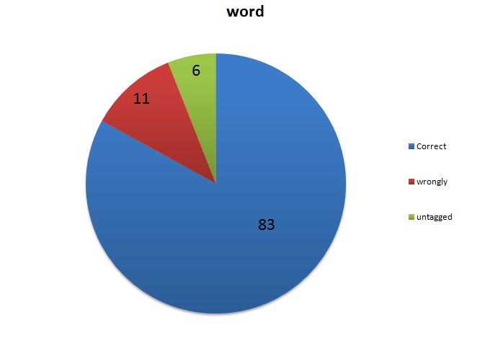
for testing and evaluation purposes, frequently-used 3257 words from classical Tamil were taken as input in the analyzer The result of word-level analysis is as follows: 2706 (83%) words were analyzed correctly; 359 (11%) words were analyzed wrongly and 194 (6%) of words were un-analyzed.

Slide 21
நன்றி

